Slide 1


nervous system
Dr. Mahdi H. Hammadi
PhD Sc. Clinical Physiology

Slide 2
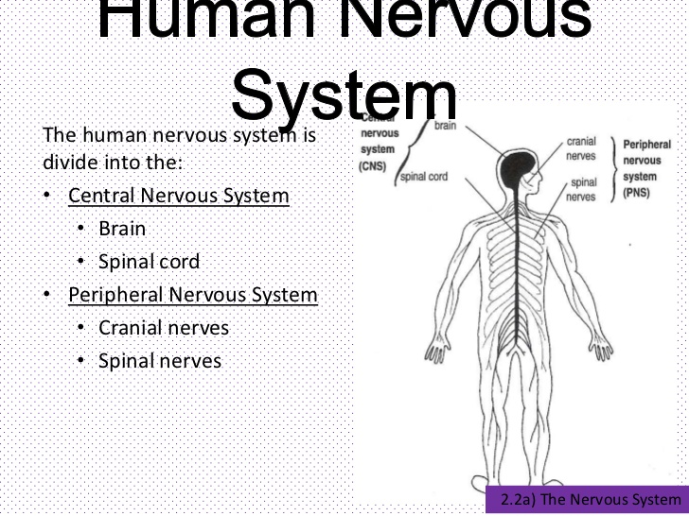

Slide 3
The peripheral nervous system (PNS) is composed of:
spinal nerves that branch from the spinal cord
And cranial nerves that branch from the brain.
The PNS includes the autonomic nervous system, which controls vital functions such as breathing, digestion, heart rate, and secretion of hormones.

Slide 4
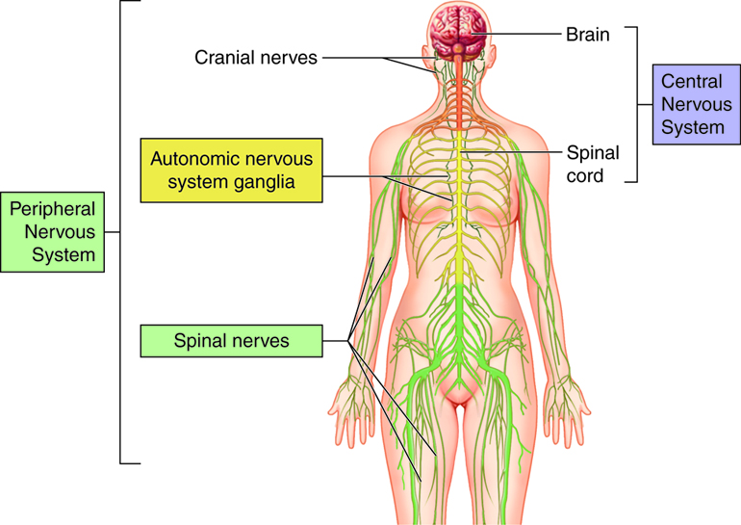

Slide 5
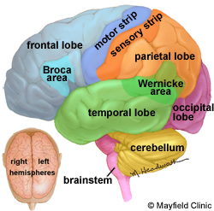
Brain
The brain is composed of the cerebrum, cerebellum, and brainstem

Slide 6
The cerebrum :
The cerebellum :
The brainstem includes:
1. the midbrain
2. pons
3. Medulla.

Slide 7
Right brain – left brain:
The right and left hemispheres of the brain are joined by a bundle of fibers called the corpus callosum that delivers messages from one side to the other. Each hemisphere controls the opposite side of the body. If a brain tumor is located on the right side of the brain, your left arm or leg may be weak or paralyzed.
Not all functions of the hemispheres are shared. In general, the left hemisphere controls speech, comprehension, arithmetic, and writing. The right hemisphere controls creativity, spatial ability, artistic, and musical skills. The left hemisphere is dominant in hand use and language in about 92% of people.

Slide 8
Lobes of the brain:
The cerebral hemispheres have distinct fissures, which divide the brain into lobes.

Slide 9
Each hemisphere has 4 lobes:

Slide 10
Cranial nerves
The brain communicates with the body through the spinal cord and twelve pairs of cranial nerves

Slide 11
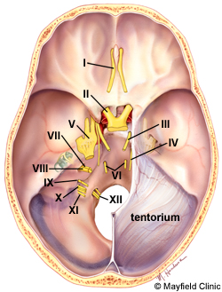

Slide 12
Ventricles and cerebrospinal fluid
The brain has hollow fluid-filled cavities called ventricles (Fig. 7). Inside the ventricles is a ribbon-like structure called the choroid plexus that makes clear colorless cerebrospinal fluid (CSF). CSF flows within and around the brain and spinal cord to help cushion it from injury. This circulating fluid is constantly being absorbed and replenished.

Slide 13
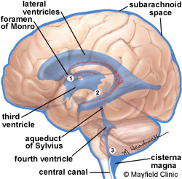

Slide 14
